Slide 1

Director Briefing Document
July 2019

Slide 2
Contents
1 | Company Overview
2 | Board Bios
3 | Executive Bios
4 | Board Calendar
5 | Director Compensation

Slide 3
Company Overview

Slide 4

Company Overview
Equinix
Equinix provides compute, interconnection and colocation services and related offerings. The company operates International Business Exchange (IBX) data centers, across the Americas; Europe, Middle East and Africa (EMEA); and Asia-Pacific geographic regions where customers directly interconnect with a network ecosystem of partners and customers.
Data Center Solutions: The company’s IBX data centers provides its customers with secure, reliable and robust environments that are necessary to aggregate and distribute information globally. These IBX data centers include multiple layers of physical security, scalable cabinet space availability, on-site trained staff (24x7x365), dedicated areas for customer care and equipment staging, redundant AC/DC power systems and other redundant and fault-tolerant infrastructure systems.
Interconnection Solutions: The company’s interconnection solutions are evolving to enable high-performance, secure, scalable, reliable and cost-effective interconnection and traffic exchange between Equinix customers across its global platform. These interconnection solutions are either on a one-to-one basis with direct cross connects or on a one-to-many basis through its Equinix Cloud Exchange (ECX) Fabric or other exchange solutions.
Platform Services: The company’s platform services offer the expertise and tools to help companies create and grow as digital businesses. Its experienced professionals are supporting leading global companies in their digital transformation projects and know which strategies, systems, and IT services and architectures best support business goals in a variety of industries, leveraging existing and emerging technologies.
*Source: Annual Filing (Form 10-K, FY2018)

Slide 5
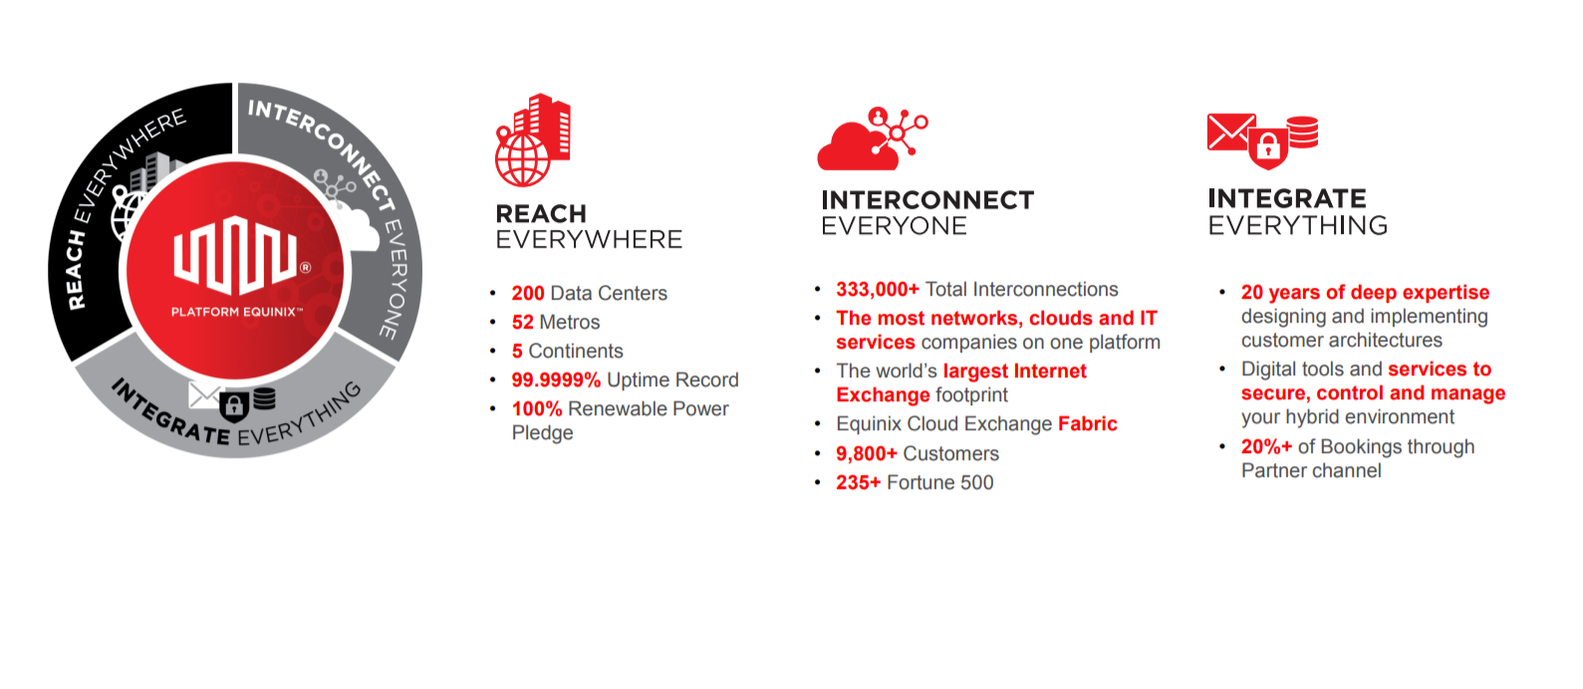
Company Overview (continued)
Source: 2019 Investor Relations Presentation

Slide 6
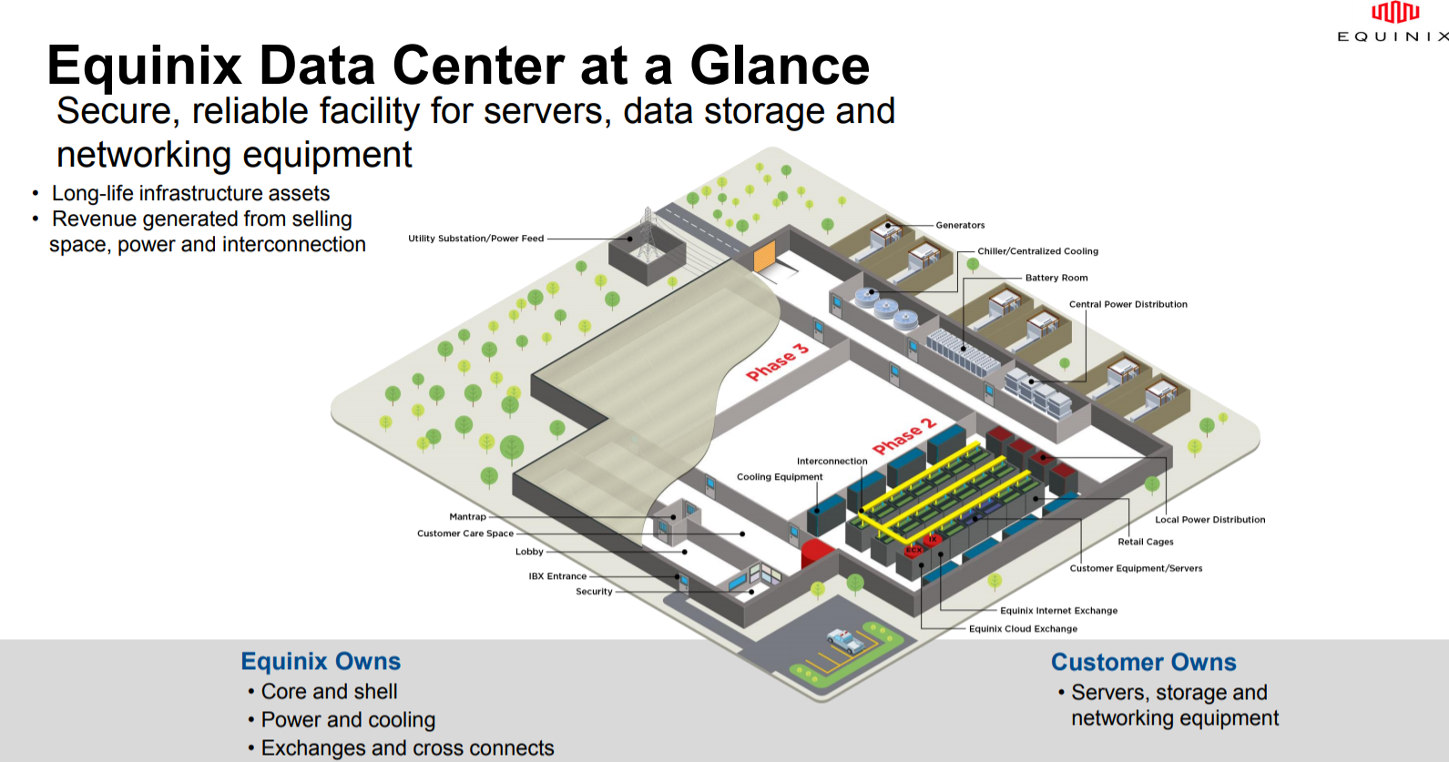
Company Overview (continued)
Source: 2019 Investor Relations Presentation

Slide 7
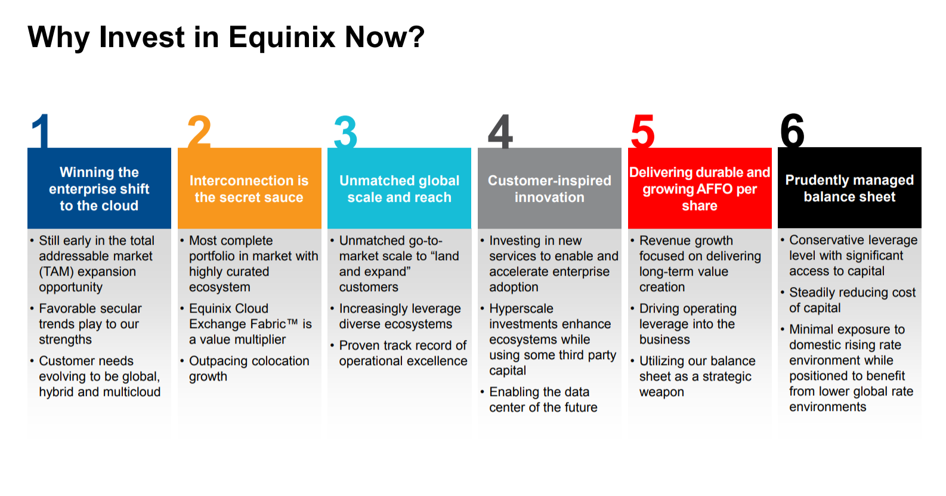
Company Overview (continued)
Source: 2019 Investor Relations Presentation

Slide 8

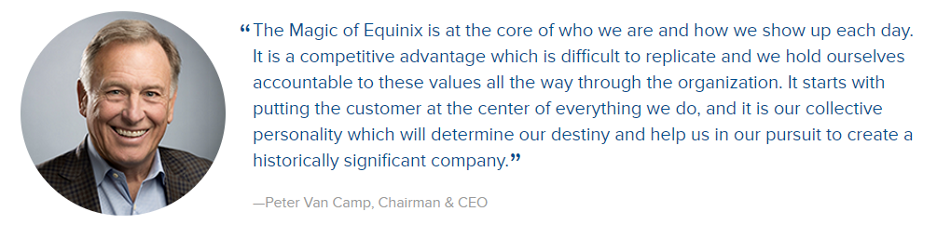








Equinix’s Culture

Slide 9
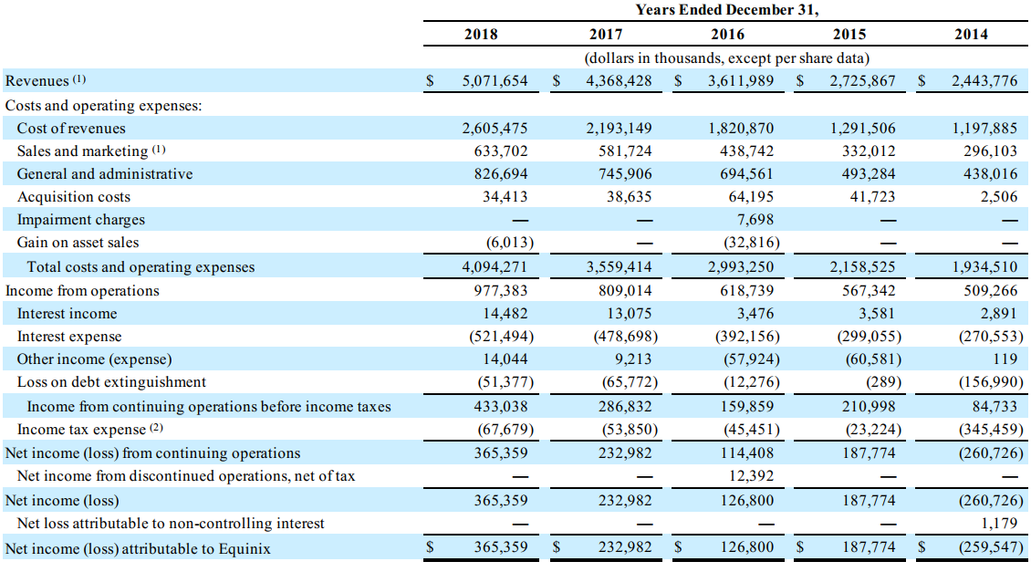
Company Overview (continued)
Financial Performance
Source: Annual Filing (Form 10-K, FY2018)

Slide 10
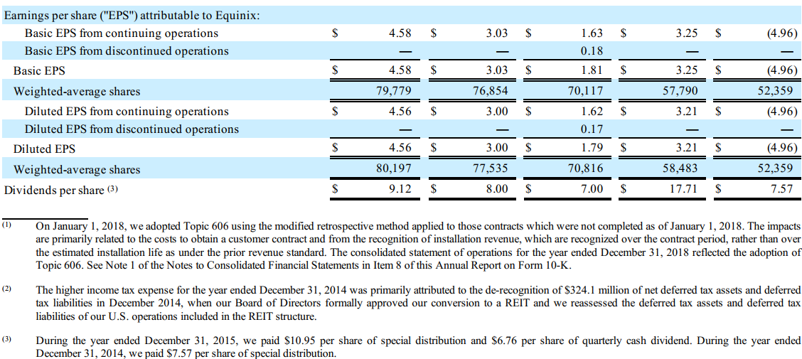
Company Overview (continued)
Financial Performance
Source: Annual Filing (Form 10-K, FY2018)

Slide 11
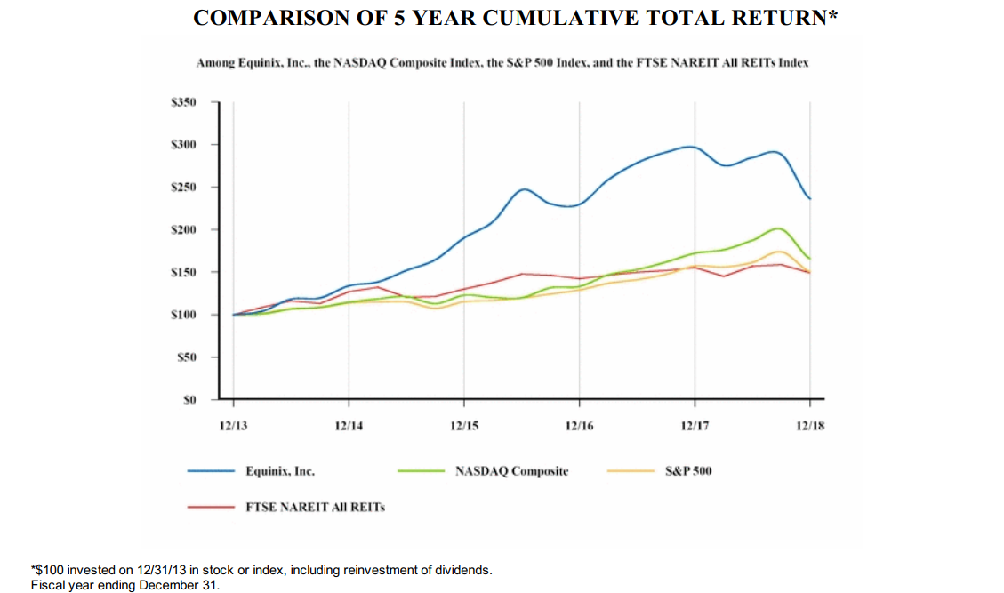
Company Overview (continued)
Stock Performance Graph
Source: Annual Filing (Form 10-K, FY2018)

Slide 12
Board Bios

Slide 13
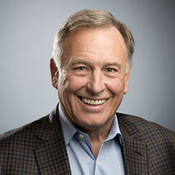
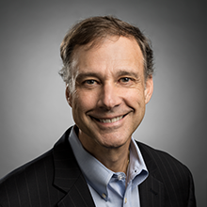
Board Bios
Peter Van Camp
Executive Chairman, and Member of the Board’s Stock Award Committee
Peter Van Camp serves as the Executive Chairman, a position he was appointed to in April 2007. Prior to this position, Mr. Van Camp served as the Chief Executive Officer and as a director since May 2000, and as president since March 2006. In addition, in December 2005, Mr. Van Camp was re-elected as Chairman of the Board, having previously served in that capacity from June 2001 to December 2002. From 1997 to 2000, Mr. Van Camp was employed at UUNET, the Internet division of MCI (formerly known as WorldCom), where he served as President of Internet Markets and as President of the Americas region. During the period from 1995 to 1997, Mr. Van Camp was President of Compuserve Network Services, an Internet access provider. Before holding this position, Mr. Van Camp held various positions at Compuserve from 1982 to 1995.
Mr. Van Camp currently serves on the board of directors of the Damon Runyon Cancer Research Foundation.
Thomas (Tom) Bartlett
Non-Executive Director and Member of the Board’s Audit Committee
Tom Bartlett has served as a member of the Board since April 2013. Mr. Bartlett has served as Executive Vice President and Chief Financial Officer of American Tower, an owner and operator of wireless and broadcast communications sites that operates as a REIT, since April 2009 and as treasurer since July 2017, having previously served in that role from February 2012 until December 2013. Prior to joining American Tower, Mr. Bartlett spent 25 years at Verizon Communications and its predecessor companies in numerous operations and business development roles, most recently as Senior Vice President and Corporate Controller from November 2005. Mr. Bartlett began his career at Deloitte, Haskins & Sells.

Slide 14
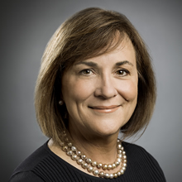
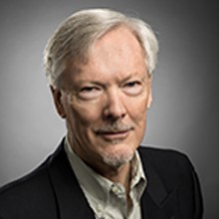
Board Bios (continued)
Nanci Caldwell
Non-Executive Director, and Chairman of the Board’s Governance Committee
Nanci Caldwell has served as a member of the Board since December 2015. Since 2005, Nanci has been a corporate director of many public and private companies. Prior to her role as a corporate director, Ms. Caldwell served as Executive Vice President and Chief Marketing Officer of PeopleSoft from 2001 to 2004. Prior to joining PeopleSoft, Ms. Caldwell spent nearly two decades at Hewlett Packard in increasingly senior and executive sales and marketing roles in Canada and the United States. Ms. Caldwell currently serves as a director on the public Boards of CIBC, Talend, Citrix Systems and Donnelly Financial Solutions.
Gary Hromadko
Non-Executive Director, and Member of the Board’s Nominating, Real Estate and Audit Committees
Gary Hromadko has served as a member of the Board since June 2003. Mr. Hromadko was a venture partner at Crosslink Capital, a venture capital firm, from June 2002 through December 2017. Mr. Hromadko has been active as a private investor since 1993. Mr. Hromadko serves on the board of directors of several privately held companies.

Slide 15
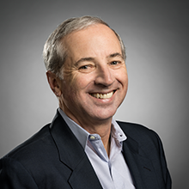
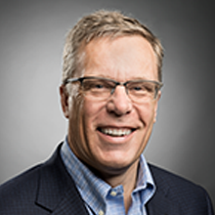
Board Bios (continued)
Scott Kriens
Non-Executive Director, Chairman of the Board’s Nominating Committee, and Member of the Board’s Compensation Committee
Scott Kriens has served as a member of the Board since July 2000. Mr. Kriens has served as Chairman of the Board of Directors of Juniper Networks, a publicly traded Internet infrastructure solutions company, since October 1996. From October 1996 to September 2008, Mr. Kriens served as Juniper's Chief Executive Officer. From April 1986 to January 1996, Mr. Kriens served as Vice President of Sales and Vice President of Operations at StrataCom, a telecommunications equipment company, which he co-founded in 1986.
William (Bill) Luby
Non-Executive Director and Member of the Board’s Nominating and Compensation Committees
William Luby has served as a member of the Board since April 2010. Mr. Luby has served as the Managing Partner of Seaport Capital, a private equity firm, and its predecessor companies since 1996. He previously was a Managing Director at Chase Capital, the private equity affiliate of the Chase Manhattan Corporation. Mr. Luby also serves on the board of directors of several privately held companies, and previously served as Chairman of the Board of Directors of Switch & Data Facilities Company, a public company, prior to its acquisition by Equinix in 2010. Mr. Luby has been an active investor in the telecommunications industry for over 20 years.

Slide 16
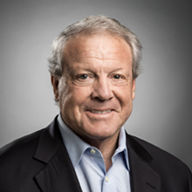
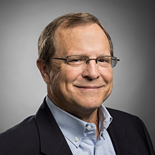
Board Bios (continued)
Irving (Bud) Lyons, III
Non-Executive Director, Chairman of the Board’s Compensation Committee, and Member of the Board’s Real Estate and Stock Award Committees
Irving Lyons, III has served as a member of the Board since February 2007. Mr. Lyons has been a principal of Lyons Asset Management, a California-based private investment firm, since January 2005. From December 1993 to January 2005, Mr. Lyons was employed at ProLogis, a global provider of distribution facilities and services, where he served as Chief Investment Officer from March 1997 to December 2004 and as Vice Chairman of the Board of Directors from December 2001 to January 2005. Mr. Lyons serves on the Boards of Directors and as Lead Independent Director of the publicly traded REITs ESSEX Property Trust and ProLogis.
Christopher (Chris) Paisley
Non-Executive Director, Chairman of the Board’s Audit Committee, and Member of the Board’s Governance and Real Estate Committees
Christopher Paisley has served as a member of the Board since July 2007 and as Lead Independent Director since February 2012. Mr. Paisley has been the Dean's Executive Professor of Accounting at the Leavey School of Business at Santa Clara University since January 2001. From September 1985 until May 2000, Mr. Paisley was the Senior Vice President of Finance and Chief Financial Officer of 3Com. Mr. Paisley currently serves as a Director of Ambarella, Fitbit, and Fortinet, all of which are public companies.

Slide 17
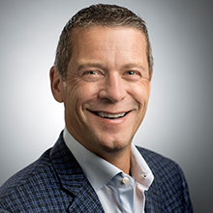
Board Bios (continued)
Charles Meyers
President, Chief Executive Officer, and Member of the Board’s Stock Award Committee
Charles Meyers joined Equinix in 2010 as President of Equinix Americas, leading the company’s largest P&L through a time of significant growth and strong operating performance. Mr. Meyers then served as the Chief Operating Officer at Equinix, where he led the Global Sales, Marketing, Operations and Customer Success teams. For the past year, he was President of Strategy, Services and Innovation (SSI) leading Equinix’s strategic business teams including Corporate Strategy, Technology Innovation, and Product Management and Engineering. Under Mr. Meyers’ leadership, SSI worked to optimize the company’s position as a cloud enabler, identify key growth areas, and evolve our services portfolio in response to market, competitive and technology trends.
Mr. Meyers has built a distinguished 25-year career in the high-tech industry. Before joining Equinix, Mr. Meyers served as Group President at Verisign where he led a P&L portfolio including the company’s Security, Communications and Mobile Messaging businesses. Prior to Verisign, Mr. Meyers held various executive positions at Level 3 Communications, including Group Vice President of Global Marketing, President of IP and Data Services, and Senior Vice President of Softswitch Services. During his tenure, Mr. Meyers helped Level 3 emerge as a premier global provider of Internet and VoIP services.
Mr. Meyers also held senior operating roles at BellSouth, was a member of the pre-IPO executive team at Internet Security Systems and served as a Senior Associate with Booz-Allen & Hamilton Consulting.
Mr. Meyers earned dual master’s degrees from Northwestern University’s J.L. Kellogg Graduate School of Management and McCormick Graduate School of Engineering. He also holds a B.S. in Chemical Engineering from the University of Colorado.

Slide 18
Executive Bios

Slide 19
Executive Bios
Peter Van Camp
Executive Chairman
Peter Van Camp serves as the Executive Chairman, a position he was appointed to in April 2007. Prior to this position, Mr. Van Camp served as the Chief Executive Officer and as a director since May 2000, and as president since March 2006. In addition, in December 2005, Mr. Van Camp was re-elected as Chairman of the Board, having previously served in that capacity from June 2001 to December 2002. From 1997 to 2000, Mr. Van Camp was employed at UUNET, the Internet division of MCI (formerly known as WorldCom), where he served as President of Internet Markets and as President of the Americas region. During the period from 1995 to 1997, Mr. Van Camp was President of Compuserve Network Services, an Internet access provider. Before holding this position, Mr. Van Camp held various positions at Compuserve from 1982 to 1995.
Mr. Van Camp currently serves on the board of directors of the Damon Runyon Cancer Research Foundation.

Slide 20
Executive Bios (continued)
Charles Meyers
President and Chief Executive Officer
Charles Meyers joined Equinix in 2010 as President of Equinix Americas, leading the company’s largest P&L through a time of significant growth and strong operating performance. Mr. Meyers then served as the Chief Operating Officer at Equinix, where he led the Global Sales, Marketing, Operations and Customer Success teams. For the past year, he was President of Strategy, Services and Innovation (SSI) leading Equinix’s strategic business teams including Corporate Strategy, Technology Innovation, and Product Management and Engineering. Under Mr. Meyers’ leadership, SSI worked to optimize the company’s position as a cloud enabler, identify key growth areas, and evolve our services portfolio in response to market, competitive and technology trends.
Mr. Meyers has built a distinguished 25-year career in the high-tech industry. Before joining Equinix, Mr. Meyers served as Group President at Verisign where he led a P&L portfolio including the company’s Security, Communications and Mobile Messaging businesses. Prior to Verisign, Mr. Meyers held various executive positions at Level 3 Communications, including Group Vice President of Global Marketing, President of IP and Data Services, and Senior Vice President of Softswitch Services. During his tenure, Mr. Meyers helped Level 3 emerge as a premier global provider of Internet and VoIP services.
Mr. Meyers also held senior operating roles at BellSouth, was a member of the pre-IPO executive team at Internet Security Systems and served as a Senior Associate with Booz-Allen & Hamilton Consulting.
Mr. Meyers earned dual master’s degrees from Northwestern University’s J.L. Kellogg Graduate School of Management and McCormick Graduate School of Engineering. He also holds a B.S. in Chemical Engineering from the University of Colorado.

Slide 21
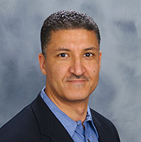
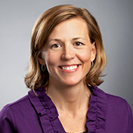
Executive Bios (continued)
Raouf Abdel
Executive Vice President, Global Operations
Raouf Abdel joined Equinix in 2012, and currently serves as Head of Global Operations overseeing engineering, construction, and operations for the company. Previously, he served as Regional Operating Chief, Americas where he successfully led IBX Operations through significant growth and expansion. Mr. Abdel has 30 years of experience in the datacenter, telecom, and construction industries. Prior to joining Equinix, he was President and CEO for OpTerra Energy Group where he was responsible for building the company’s business plan, securing funding and day to day operations. Before that, Mr. Abdel was President of Business Markets Group at Level 3 Communications where he led the company's $1 billion Enterprise business unit. He also held numerous leadership roles at Level 3 in network deployment, product development and M&A. Prior to Level 3, Mr. Abdel served as Vice President of Network Deployment at MFS Communications and was responsible for network and facility deployment throughout the US, Europe and Asia.
Mr. Abdel holds a B.S. in Electrical Engineering from Temple University.
Sara Baack
Chief Marketing Officer
Sara Baack joined Equinix in 2012 as Chief Marketing Officer, and is responsible for the company’s overall global brand, product and service portfolio, industry analysis, communications and vertical market development. Ms. Baack brings to Equinix more than 20 years of strategic corporate experience, joining the company from Level 3 Communications, where she served in a variety of senior positions, most recently as Senior Vice President of Voice Services. In this role, Ms. Baack was responsible for strategy, product management, pricing and commercial support, interconnection/regulatory policy, vendor management, network planning and routing for the $1 billion business unit. In addition to her career at Level 3, Ms. Baack also worked at PaineWebber Incorporated as Vice President of Principal Transactions where she invested proprietary private equity capital in the communications sector.
Ms. Baack holds a B.A. from Rice University and an M.B.A. from Harvard Business School.

Slide 22
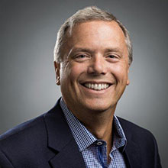
Executive Bios (continued)
Michael Campbell
Chief Sales Officer
As Chief Sales Officer, Michael Campbell is responsible for the strategy and execution of all Equinix sales efforts globally, including direct sales and the entire ecosystem of go-to-market channel partners. He is focused on implementing strategies to expand the company’s customer base and take advantage of new business opportunities. Previously, Mr. Campbell held the role of Senior Vice President of Sales for Equinix.
Mr. Campbell joined Equinix in 2015 with over 30 years of international sales leadership experience at premier high-tech organizations. He joined Equinix from Symantec, where he ran global renewals and website security businesses that drove almost $2 billion annually. His career at Symantec began after the merger with VeriSign’s authentication business unit, which had previously acquired Guardent, where he ran the enterprise and channel sales teams. Before Guardent, Mr. Campbell led Akamai’s U.S. sales force operations and nearly doubled the company’s revenue in just one year, from $89 million to over $160 million. Mr. Campbell has also held various sales leadership positions at NCR, UUNET, CompuServe, MCI and WorldCom. Mr. Campbell holds a B.S. in marketing, with a minor in communications, from the University of Dayton.

Slide 23
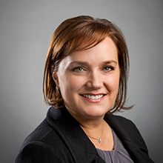
Executive Bios (continued)
Brandi Galvin Morandi
Chief Human Resource Officer, Chief Legal Officer, General Counsel and Secretary
Brandi Galvin Morandi joined Equinix in January 2003 and served as Equinix's General Counsel and Corporate Secretary until her expanded appointment was announced in early 2019. Ms. Morandi’s global organization stewards the Magic of Equinix culture through engagement, development, and compliance. From the first introduction, through onboarding, and finding success as they grow their career with Equinix, her team is at the forefront of creating a workplace experience where all employees are engaged and empowered. Ms. Morandi has led the strategic planning required to support the ongoing growth of Equinix past 8,000-employees, which has included organic and acquisition growth.
Ms. Morandi’s legal organization acts as a strategic partner in commercial negotiations, regulatory and compliance matters, governmental affairs and corporate governance, including working closely with the Equinix Board of Directors. Her teams have completed and integrated numerous acquisitions and joint ventures globally and over $27 billion in equity and debt financings in support of Equinix’s expansion roadmap.
Prior to joining Equinix, she practiced in the corporate securities group at the law firm of Gunderson Dettmer Stough Villeneuve Franklin & Hachigian, LLP (Gunderson Dettmer) in Menlo Park, California. At Gunderson Dettmer, she represented public and private companies in a variety of debt and equity offerings, mergers and acquisitions as well as providing general corporate public company representation. Prior to her legal career, she held various positions in the field of public relations.
Ms. Morandi holds a B.A. in International Relations and Journalism from the University of Southern California and a J.D. from the University of California, Hastings College of the Law.

Slide 24
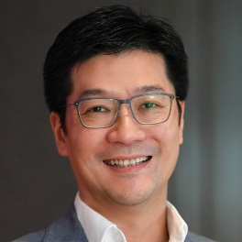
Executive Bios (continued)
Samuel Lee
President, Equinix Asia-Pacific
Samuel Lee is President of Equinix Asia-Pacific, overseeing the company’s management, strategy and growth in the region. In this role, he successfully led the growth and expansion of the company’s business in Asia-Pacific, including its acquisitions of Asia Tone, Bit-isle and Metronode in 2012, 2015 and 2018, and the ongoing integration of the company’s regional operations into its global business. Under his leadership, Equinix’s business in Asia-Pacific has undergone rapid expansion to become one of the market leaders in the region with 40 data centers in 12 markets.
With more than 25 years of experience in the IT and telecom industry, Mr. Lee is well-known as a dynamic and forward-looking business leader in the field, with proven track record in driving business growth and expansion. He joined Equinix in 2000 as Managing Director of Hong Kong, leading the company’s business strategy, sales and operations in Hong Kong. In that role, he successfully led the team in building a strong market position for Equinix in Hong Kong.
Prior to joining Equinix, Mr. Lee served as Managing Director of Pacific Gateway Exchange, overseeing the wholesale and retail business growth and development for the company. Mr. Lee has also held senior management positions at various leading technology companies, including Teleglobe International, Intel, and Sprint. In addition, he was the founder of a consulting firm offering strategic consultation services to network providers in Asia.
A native of Hong Kong, Mr. Lee holds a Bachelor of Arts degree in International Business from the City University of Hong Kong.

Slide 25
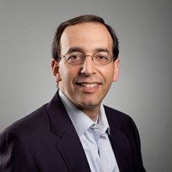
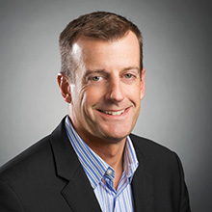
Executive Bios (continued)
Eric Schwartz
President, EMEA
Eric Schwartz joined Equinix in 2006 and has played various senior-level management roles with the company. He spearheaded Equinix’s expansion to Europe, including the 2007 acquisition of IXEurope, and the ongoing integration of Equinix’s European operations into its global business. As President of Equinix Europe, Mr. Schwartz oversees the management, strategy, and growth for Equinix in Europe. Mr. Schwartz came to Equinix from BellSouth where he was Vice President of IP Communications and led the development and implementation of advanced technologies including VoIP. Prior to joining BellSouth, he was Executive Vice President of Harold A. Dawson Company, an Atlanta-based real estate development company. Mr. Schwartz also is a former member of McKinsey & Co., where he consulted with telecommunications and financial services companies in the United States. and Asia on strategic issues.
Mr. Schwartz earned an M.B.A. from Harvard Business School and a B.S. in Electrical Engineering and a B.A. in Economics from Stanford University.
Karl Strohmeyer
President, Americas
Karl Strohmeyer joined Equinix in 2013 after 12 years at Level 3 Communications, where he was Group Vice President for the North American Enterprise Group. There, he was responsible for building and overseeing a sales force of more than 1,200 people generating approximately $2.5 billion in annual revenue. Prior to this role, Strohmeyer led the Global Carrier Channel for Level 3 and managed sales teams responsible for more than $1B in carrier and service provider revenue. During his 12-year tenure at Level 3, Strohmeyer held several executive positions, supervising commercial services and large deal teams, overseeing customer operations and client service, and managing strategic relationships with other companies, including channel partners.
Prior to Level 3, Mr. Strohmeyer worked at NetRail, where he was first an executive vice president for operations—during which time he introduced four new products to market and was part of a team that raised $85 million in capital. Later at NetRail, he was an executive VP for corporate development, helping manage the sale of the company. Mr. Strohmeyer earned a B.S. in business administration from the University of New Hampshire and a master’s degree in international business administration from Mercer University.

Slide 26
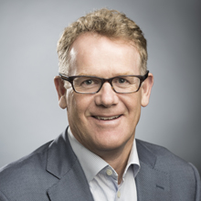
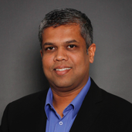
Executive Bios (continued)
Keith Taylor
Chief Financial Officer
Keith Taylor joined Equinix in 1999 and has served in a variety of roles, including Equinix's Director of Finance & Administration, Vice President of Finance & Chief Accounting Officer, and now Chief Financial Officer. Before joining Equinix, Mr. Taylor served as Vice President of Finance and Controller for International Wireless Communications, an operator, owner, and developer of wireless communication networks throughout Asia and Latin America. Prior to joining International Wireless Communications, Mr. Taylor was employed by Becton Dickinson & Company, a medical and diagnostic device manufacturer, as a Senior Sector Analyst for the diagnostic businesses in Asia, Latin America, and Europe.
Mr. Taylor holds a B.B.A. from Bishop's University in Quebec, Canada, and is a member of the Canadian Institute of Chartered Accountants.
Milind Wagle
Chief Information Officer
Milind Wagle joined Equinix in April 2010 and serves as the Global Chief Information Officer within the Customer Success Organization. Wagle leads the global IT team and oversees the solution delivery for enterprise applications, information security, and end-user technology infrastructure support for Equinix’s thousands of global employees.
For the past six years, Wagle has served in various senior leadership roles within the IT team at Equinix, most recently as Vice President. In addition to managing the global IT applications portfolio, he has managed large-scale, cross-functional enterprise transformation programs for the company, including designing and deploying process, system and organizational standardization across the globe. Previously, he has held leadership positions at VeriSign, KPMG Consulting and BearingPoint.
Mr. Wagle holds a BS, Electronics Engineering from University of Mumbai.

Slide 27
Board Calendar

Slide 28
2019 Board Calendar
Board/Committee | Confirmed Date | Confirmed Time/Place
Board of Directors Dinner | Wednesday - March 6, 2019 | HQ – Redwood City, CA
Board of Directors Meeting (Private Session) | Thursday - March 7, 2019 | HQ – Redwood City, CA
Board of Directors Dinner | Wednesday - May 22, 2019 | Equinix NY Office
Board of Directors Meeting | Thursday - May 23, 2019 | Equinix NY Office
Board of Directors Dinner & Meeting (2-Day Strategy Session) | Wednesday - September 25, 2019 | Carmel Valley Ranch
Board of Directors Meeting (Strategy Session continued) | Thursday - September 26, 2019 | Carmel Valley Ranch
Board of Directors Dinner | Tuesday - December 17, 2019 | HQ – Redwood City, CA
Board of Directors Meeting (Private Session - Budget Review) | Wednesday - December 18, 2019 | HQ – Redwood City, CA

Slide 29
2020 Board Calendar
Board/Committee | Confirmed Date | Confirmed Time/Place
Board of Directors Dinner (Private Session) | Wednesday - March 4, 2020 | HQ – Redwood City, CA
Board of Directors Meeting | Thursday - March 5, 2020 | HQ – Redwood City, CA
Board of Directors Meeting (Private Session) | Wednesday – June 3, 2020 | Equinix – Ashburn, VA
Board of Directors /Executive Staff Dinner | Wednesday – June 3, 2020 | Equinix – Ashburn, VA
Board of Directors Meeting | Thursday – June 4, 2020 | Equinix – Ashburn, VA
Board of Directors Meeting | Wednesday – September 16, 2020 | Carmel / Napa (TBC)
Board of Directors / Executive Staff Dinner | Wednesday – September 16, 2020 | Carmel / Napa (TBC)
Board of Directors Meeting | Thursday – September 17, 2020 | Carmel / Napa (TBC)
Board of Directors Dinner (Private Session) | Wednesday – December 16, 2020 | HQ – Redwood City, CA
Board of Directors Meeting | Thursday – December 17, 2020 | HQ – Redwood City, CA

Slide 30
Director Compensation

Slide 31
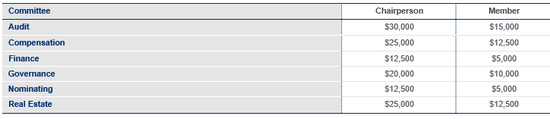
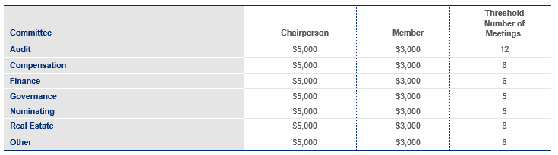
Non-employee directors receive a retainer in connection with their service on the Board of $70,000. In addition, in lieu of regular meeting fees, committee chairs (if any) and members receive the following annual retainers payable quarterly in arrears: Currently, non-employee directors only receive meeting fees for attendance at committee meetings in excess of a specified number of meetings in a calendar year. The committee meeting fees and the threshold number of meetings that must be attended before any meeting fees are paid are:
Director Compensation
Non-employee directors receive automatic grants of RSUs. At our annual meeting of stockholders, each non-employee director who will continue to be a director after that meeting is automatically granted an award of RSUs. The grant date fair value of these annual awards is $250,000. The automatic RSU awards become fully vested on the earlier of (i) the first anniversary of Equinix’s immediately preceding annual meeting of stockholders or (ii) in the case of a non-employee director not standing for reelection, the date of the first annual meeting of stockholders held subsequent to the date of grant. In addition, each non-employee director receives a prorated award of RSUs upon joining the Board with a grant date fair value of $250,000. The proration is based upon a fraction equal to (x) the number of days from the start date of the non-employee director until the first anniversary of the date of Equinix’s immediately preceding annual meeting of stockholders divided by (y) 365. The number of shares subject to each RSU award is determined by dividing the specified dollar value of the award by the closing price of Equinix’s common stock on the date of grant. The RSUs granted to our directors will become fully vested if Equinix is subject to a change-in-control; in the event of the non-employee director’s death, the portion of the RSUs that would have become vested on the next scheduled vesting date will become fully vested. Directors accrue dividend equivalent units on their RSUs. We allow our non-employee directors to elect to defer settlement of their RSUs.
The Board has established a stock ownership requirement for Equinix’s non-employee directors to encourage them to have a significant financial stake in Equinix. Each non-employee director should own not less than six times their cash annual retainer for general service on the Board in shares of Equinix’s common stock, including exercised stock options, vested restricted stock units (“RSUs”) and deferred RSUs. New non-employee directors will have five years from the date of their election to the Board to comply.

